Slide 1

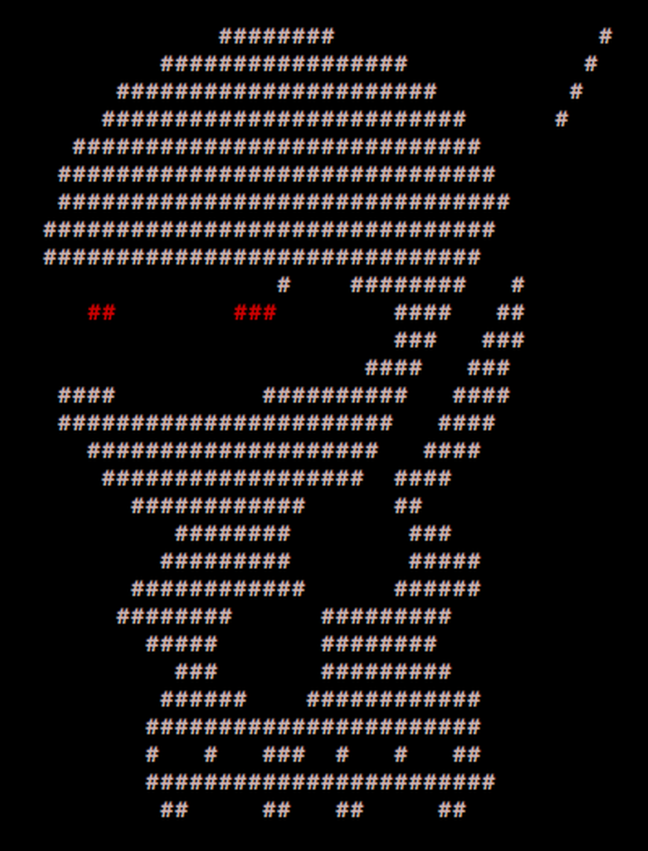
____ _____ _ _
/ ___| ___ __|_ _|_ _| | | _____
\___ \ / _ \/ __|| |/ _` | | |/ / __|
___) | __/ (__ | | (_| | | <\__ \
|____/ \___|\___||_|\__,_|_|_|\_\___/
PER0x54
Technical (in)security talks & hands-on challenges, no bullshit!
Technical (in)security talks & hands-on challenges, no bullshit!

Slide 2
Welcome!
We’re back!
Greetings nerds
Technical (in)security talks & hands-on challenges, no bullshit!

Slide 3
SecTalks PER0x54
Thanks to…
Someone for the brews :anyone?:
Spacecubed & Riff!
The committee nidogski (off somewhere crying about BSides prep!) & sudosammy
Everyone who contributes!
Technical (in)security talks & hands-on challenges, no bullshit!
Notes:
Have a line up of lightening talks tonight

Slide 4
Speakers PER0x54
“Nightmare for SMB when they get hacked
and then my phone rings”
Synopsis: Paresh will run through couple of examples where he did incident response for SMB businesses that had been hacked and compromised.
Bio: Paresh Kerai is a Technical Manager at Sapien, and a security researcher specialising in cyber security for control systems and network infrastructure
Technical (in)security talks & hands-on challenges, no bullshit!
Notes:
Conor is an evolutionary mass of atoms whose sole instinct is survival. Works as a Security Analyst who primarily focuses on detection engineering and data analysis – finding data, gathering data, parsing data, employing that data to do wonderful things. He embodies the ‘fuck around and find out’ mindset and applies it to every project.

Slide 5

SecTalks PER0x55
Date: ????
(the randomest day of every month)
Speaker: ??? ← This could be you!
Title: ??? ← This could be anything!
https://goo.gl/4FT53i
Technical (in)security talks & hands-on challenges, no bullshit!

Slide 6
BSides Perth 2021
www.bsidesperth.com.au
If you didn’t get a ticket
…make sad noises…or buy a
Virtual Ticket and tune in
to the livestream!
Technical (in)security talks & hands-on challenges, no bullshit!

Slide 7



Stay in touch
IRC / SLACK
irc.sectalks.org > #sectalks
and / or ask to be added to the slack
Github
https://github.com/sectalks/sectalks
Twitter
@SecTalks
Technical (in)security talks & hands-on challenges, no bullshit!

Slide 8
Without further ado...
drinks?
~ ~
( o )o)
( o )o )o)
(o( ~~~~~~~~o
( )' ~~~~~~~'
( )|) |-.
o| _ |-. \
o| |_||_) | \ \
| | ||_) | | |
o| | / /
| |." "
| |- '
.========.
Technical (in)security talks & hands-on challenges, no bullshit!

